Slide 1
Cloud Networking
Using AWS

Slide 2
Welcome!
Agenda:
Intro
Intro to IP’s
Morning Tea
Basic Network Set Up
Network Testing
Lunch
Guest Speaker (Jess Fraser)
Photo 📸
Afternoon Tea
Deploy an App
Whiteboarding
Wrap-Up

Slide 3
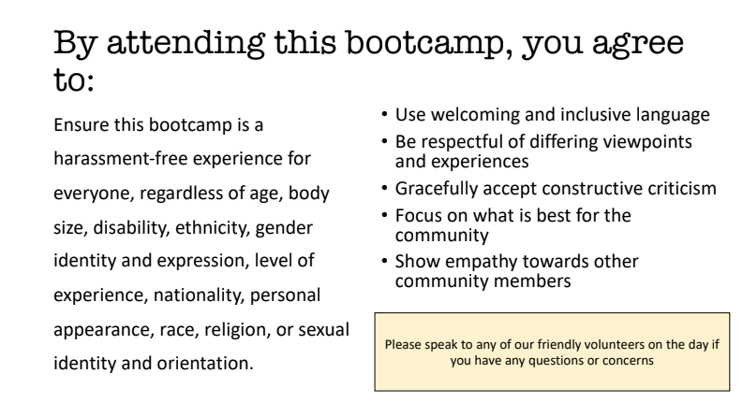
Code of Conduct

Slide 4
Logistics Check List
Toilets
Water/Coffee/Tea
Building Access
Fire Evacuation

Slide 5

Why are you here today?
Let’s discuss in our groups
Image sourced from: https://broadlygenderphotos.vice.com/

Slide 6
Thank you for your sponsorship and providing a location and food

Slide 7
Thank you for your sponsorship and providing AWS account credits

Slide 8






Two Modes of Learning
Theory
We’ll introduce you to some concepts and answer questions
Hands On
We’ll jump into the AWS console and start creating our cloud networks

Slide 9
Networking Intro
Virtual Private Cloud (VPC)
CIDR Range
Subnets
Internet Gateway (IGW)
NAT Gateway
Direct Connect/VPN
VPC Peering
Route Table
Network Access Control List
Defines where network traffic can go
Isolated part of the cloud of your AWS services
Connecting VPCs
Connects your VPC to the internet
Securely connect a private subnet to a public subnet
A subset of your VPC
Securely connect your VPC to on-prem infra
Set of rules to block/allow inbound/outbound network traffic
Determines number of IPs your VPC can have

Slide 10
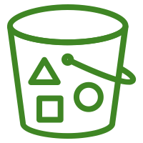
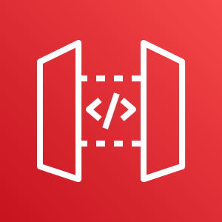

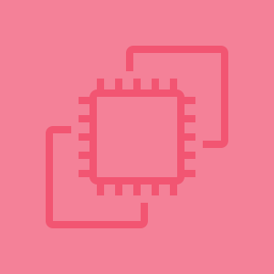

What you will create today
Private Subnet
Public Subnet
Internet
Route Table

Slide 11

Networking 101
Digital Copy:
Jvns.ca/networking-zine.pdf
Created by Julia Evans
@b0rk

Slide 12
Networking OSI Model (Open Systems Interconnection)
7 Application Layer
For human consumption – what we see 👀 eg. HTTP, SNMP, FTP
6 Presentation Layer
Processes data to be used by the app layer, including encryption/decryption, jpg, SSL, TLS
5 Session Layer
4 Transportation Layer (TCP/UDP)
Responsible for transporting packets in a way that covers flow control and reliability
3 Network Layer
Routing data from A to B going across boundaries – IP’s, ICMP, IPsec, IGMP
2 Data Link Layer
How data is linked up from point A to B eg. ARP, MAC Address
1 Physical Layer
Hardware responsible for data transmission – eg the physical cables, hubs, wireless
Creation/Tear down of network connections

Slide 13
Let’s get started!
What is a IP address?
What is a Subnet?
What is a Supernet?
Calculating Subnets
Cheat sheet exercise

Slide 14
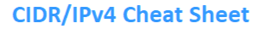
IP Exercise!
CIDR and IP visualisation tool: http://cidr.xyz/
IP & Subnet Calculator: https://tidalmigrations.com/subnet-builder/
IP & Subnet Calculator: http://www.davidc.net/networking/visual-subnet-calculator
Provided:
Task:
/24 -> divide into 4 /27 -> divide into 4 /23 -> divide into 8
how many hosts in a /28
what is the host and network address in these 10.0.0.1/25, 192.192.168.192/26 ....
what is the usable range?

Slide 15
Knowledge Check
/x is the size of the bytes
VPCs - between /16 and /8
Subnets - between /16 and /28 (CIDR blocks of the subnets cannot overlap)
AWS’s 5 reserved IPs:
Network address
VPC Router
DNS Server
‘future use’
Network Broadcast address
Subnet CIDR range cannot be the same or larger than the VPC
CIDR - Classless Inter-Domain Routing

